Slide 1

Predicting Stock Trends
CZ1115 FS8, Group 9
Chin Kin Mun, Yeap Jia Hao, Yoon Sang Won

Slide 2
Table of Contents
01
Problem Definition
Short description on selected problem
02
Data Exploration
Variable Selection, Data Extraction, Data Preparation, Data Visualizations & Analysis
03
Machine Learning
Multivariate Linear Regression with Feature Scaling
04
Conclusion
Data driven insights, Member Contributions

Slide 3
Problem Definition

Slide 4

Problem Definition
Predict long-term trends of future stock prices based on the health of the company
Chose to focus on the stock price of Apple Inc. (AAPL)
BUY?
AND
SELL?

Slide 5
Data Exploration

Slide 6
Variable Selection
Variables that affect companies’ health
Total assets
Total liabilities
Profits of the company
Dividend yield
Internal
External
Federal Interest
Data Extraction
Data Analysis
Variable Selection
Data Preparation

Slide 7
Data Extraction
Stock Prices
Total Assets
Total Liabilities
Gross Profit
Dividend
Alpha Vantage API
Federal Funds
Federal Interest Rate
2016 - Present
2009 - Present
Total Assets
Total Liabilities
Balance Sheet
Income Sheet
Gross Profit
2009 - 2015
2009 - 2015
Data Extraction
Data Analysis
Variable Selection
Data Preparation

Slide 8
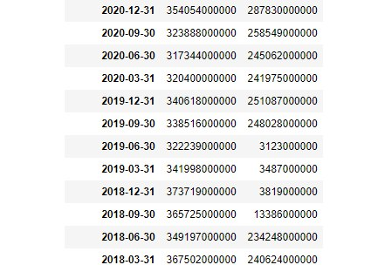
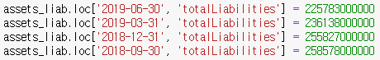
Anomalies in API data
Anomalies exist in data from API
Fixing the anomalies manually
Numbers are significantly smaller compared to other months
Data Extraction
Data Analysis
Variable Selection
Data Preparation

Slide 9
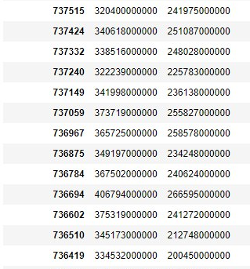
Changing Date to Ordinal Form
For linear regression and graph plotting purposes, ordinal form is used for the dates
Ordinal number represents the number of days from the first day of year 0
Dates in original format were kept separately as well for future uses
Data Extraction
Data Analysis
Variable Selection
Data Preparation

Slide 10
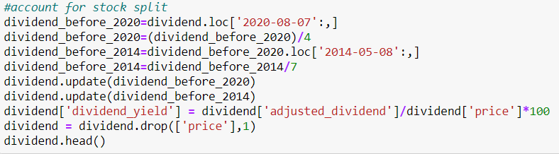
Calculating Dividend Yield
API only provides Dividend data, but Dividend Yield data is required for stock price prediction
Convert dividend into adjusted dividend
Convert adjusted dividend into dividend yield
Data Extraction
Data Analysis
Variable Selection
Data Preparation

Slide 11
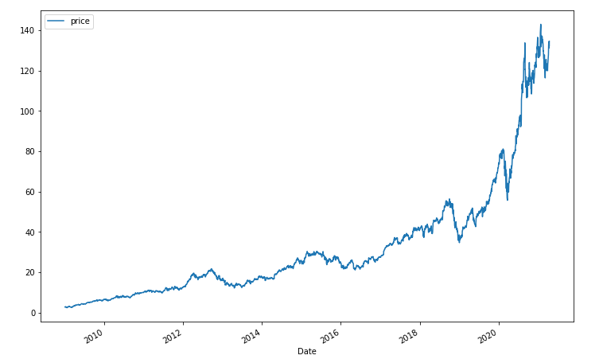
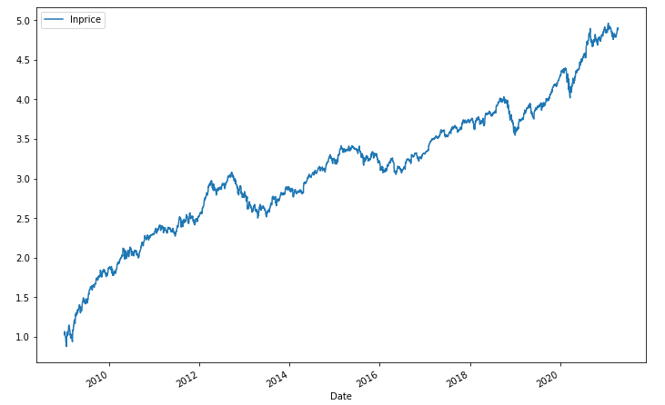
Bi-variate Plots against Time
Price
Natural Log of Price
Data Extraction
Data Analysis
Variable Selection
Data Preparation

Slide 12
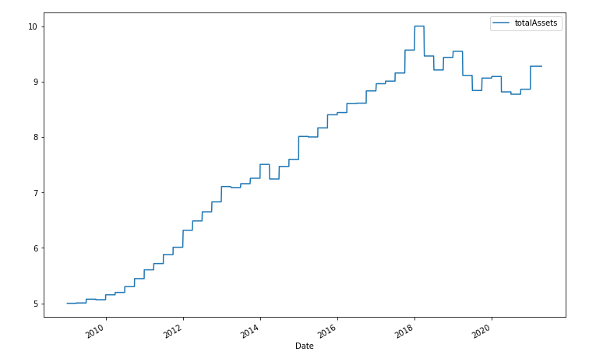
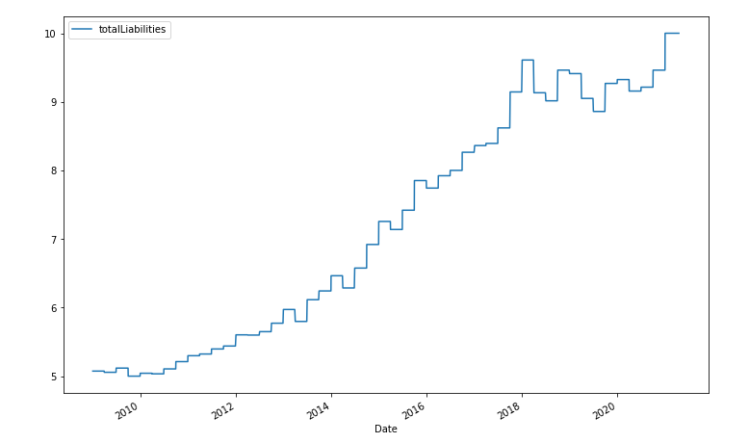
Bi-variate Plots against Time
Total Assets*
Total Liabilities*
Data Extraction
Data Analysis
* All the variables were extrapolated to match the daily data points of the stock price
Variable Selection
Data Preparation

Slide 13
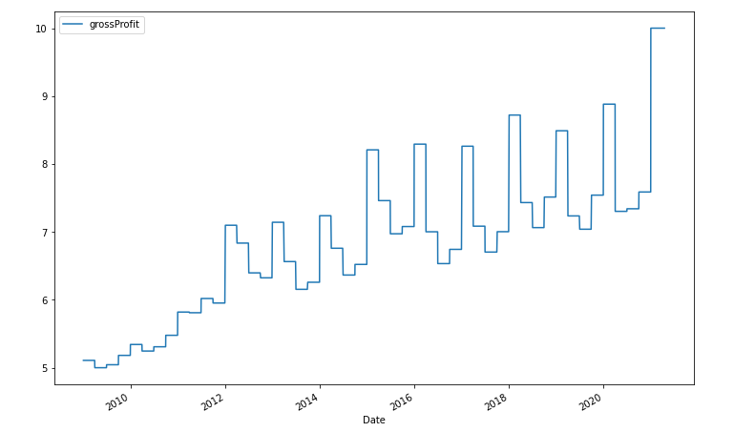
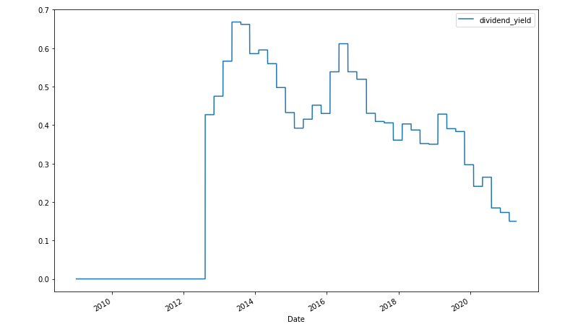
Bi-variate Plots against Time
Gross Profit*
Dividend Yield*
Data Extraction
Data Analysis
* All the variables were extrapolated to match the daily data points of the stock price
Variable Selection
Data Preparation

Slide 14
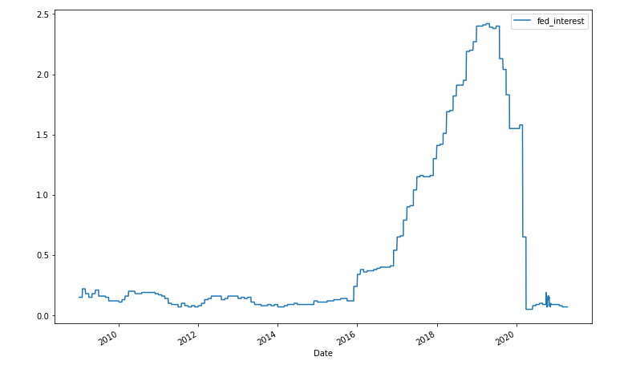
Bi-variate Plots against Time
Federal Interest Rates*
Natural Log of Price
Data Extraction
Data Analysis
* All the variables were extrapolated to match the daily data points of the stock price
Variable Selection
Data Preparation

Slide 15
Machine Learning

Slide 16
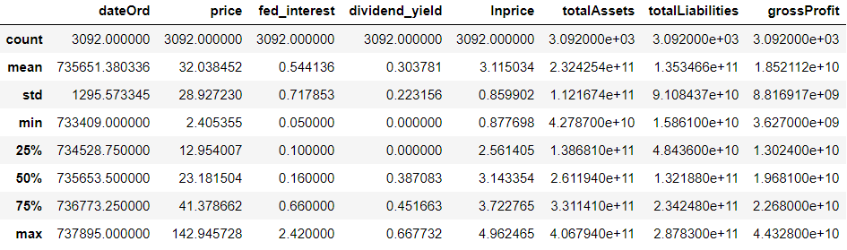
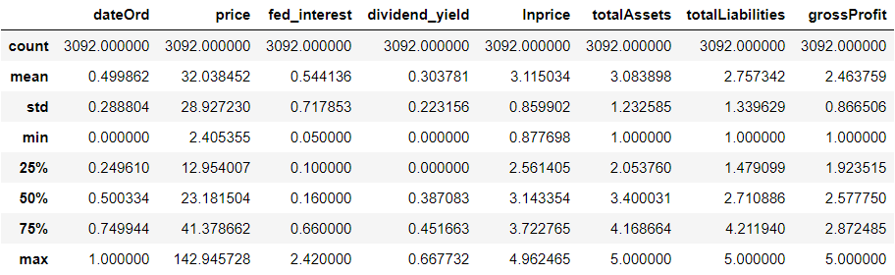
Feature Scaling
Before
Range of some variables are much bigger than other variables
Data normalization is done on these variables to improve the regression model
Apply Min-Max Scaling
After

Slide 17
Multi-Variate Linear Regression
Linear Regression
Date (Ordinal Form)
Federal Interest Rate
Dividend Yield
Total Assets
Total Liabilities
Gross Profit
Variables
Train Test Data Split
Train Set
Test Set
2009
2018
2021

Slide 18
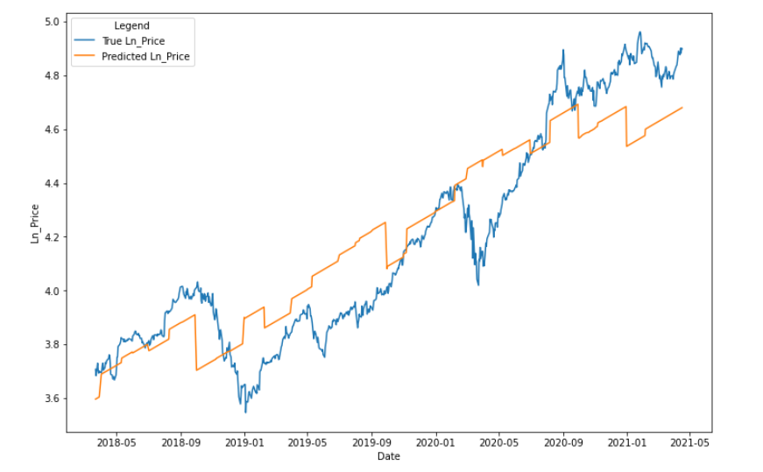
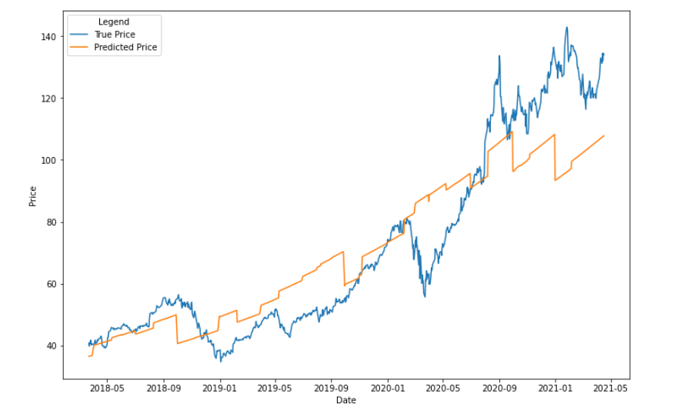
True against Predicted values
Natural Log of Price
Price

Slide 19
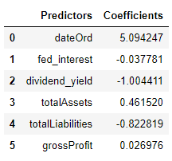
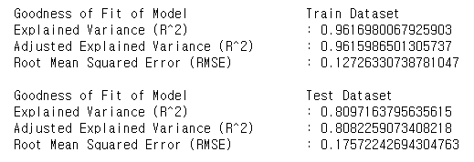
Linear Regression Outcomes
Coefficients
Performance Measures

Slide 20
What did we try and learn?
1
Complex and more accurate models for stock price prediction exists (LSTM, ARIMA etc.)
2
Unpredictability makes stock price prediction difficult
3
Adjusted Explained Variance is a good performance measure to detect overfitting in Linear Regression models
Feature Scaling is a good normalization technique to improve the performance of Linear Regression models
4

Slide 21
Conclusion

Slide 22
BUY
To End Off…
In the long-term outlook, Apple stock prices will continue rising
💎💎💎🤲🤲🤲
SELL
Contents Title
Contents Title
Get a modern PowerPoint Presentation that is beautifully designed.
Get a modern PowerPoint Presentation that is beautifully designed.

Slide 23
Member Contributions
Research Work
Video Editing
Presentation Voice-over
Presentation Slides
Data Exploration & Machine Learning
#visualizationsarecool

Slide 24
Thank You

Slide 25
Definitions
Dividend yield is defined as the financial ratio that shows how much a company pays out in dividend relative to its stock price.
Stock price shows the investor’s confidence in the company itself
Confidence can be derived by certainty of the company, whether it will survive during an economic downturn, or it can be derived by the performance of the company

Slide 26
References
https://1000logos.net/apple-logo/
https://advisortools.zacks.com/Research/Stocks/AAPL/Financials (CSV files for income and balance sheets)
https://www.free-powerpoint-templates-design.com/economical-stock-market-powerpoint-templates/ (presentation template)

